Slide 1
Final Project Allyson Meyer
Is there any economic impact on fertility rates in the US?

Slide 2
Variables
Annual Salary [ Annual_Salary ]
The average US salary for each year, sourced through United States Census Bureau.
Average Population [ Avg_Population ]
The average US salary for each year, sourced through Federal Reserve Bank of St. Louis and Wikipedia.
Total Fertility Rate [ Total_Fertility_Rate ]
The estimate average number of children a woman would give birth to in a given year in the US, sourced through Federal Reserve Bank of St. Louis and Wikipedia.

Slide 3
Variables cont’d
Consumer Price Index [ CPI ]
The measure of average change overtime in prices paid by consumers for a market basket of consumer goods and service in the US, sourced through Bureau of Labor Statistics.
House Value [ House_Value ]
The average cost of a house in a given year in the US, sourced through the Federal Reserve Bank of St. Louis.
Salary to House Ratio [ House_Ratio ]
The ratio of annual salary to the average house price in the US in a given year, calculated by House_Value / Annual_Salary.

Slide 4
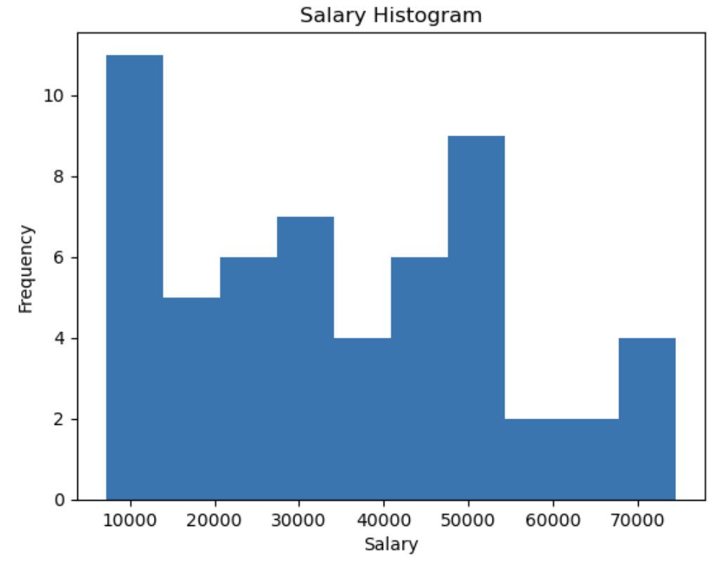
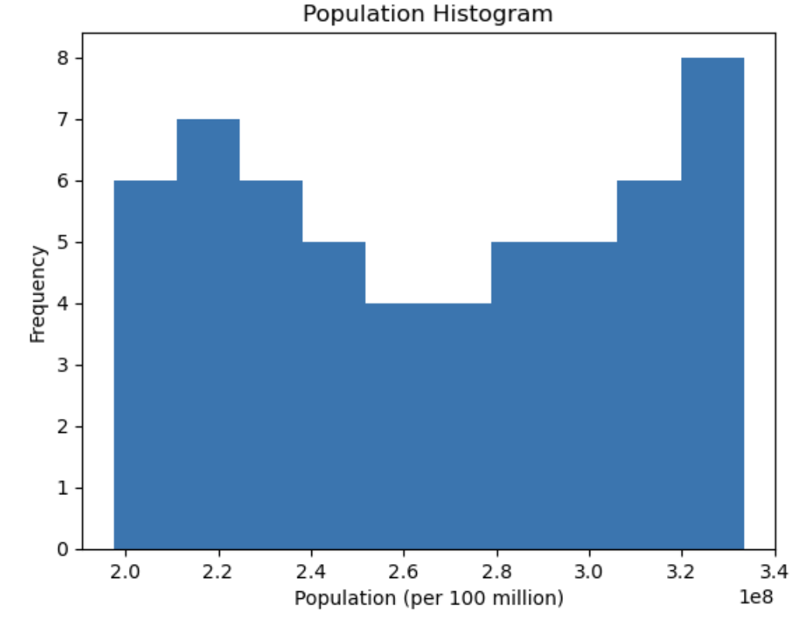
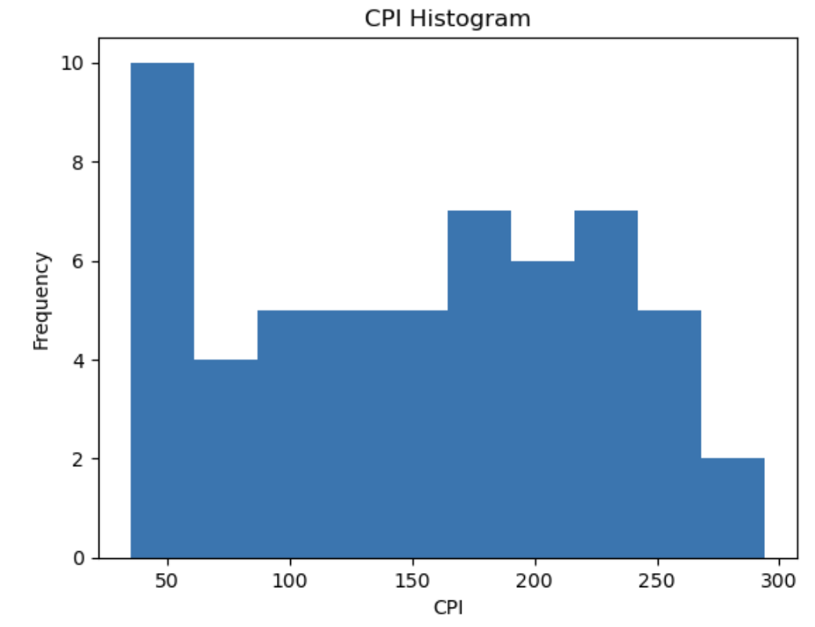
Histograms
Salary, Population, & CPI
Between these three histograms, there are not many outliers. In the CPI histogram, there is an outlier around the 275-290 CPI range, and then Salary in the 60000-70000 range as well. These outliers are due to rapid increases in their respective values. These are to be kept as outliers as removing them would get rid of important data for that year.

Slide 5
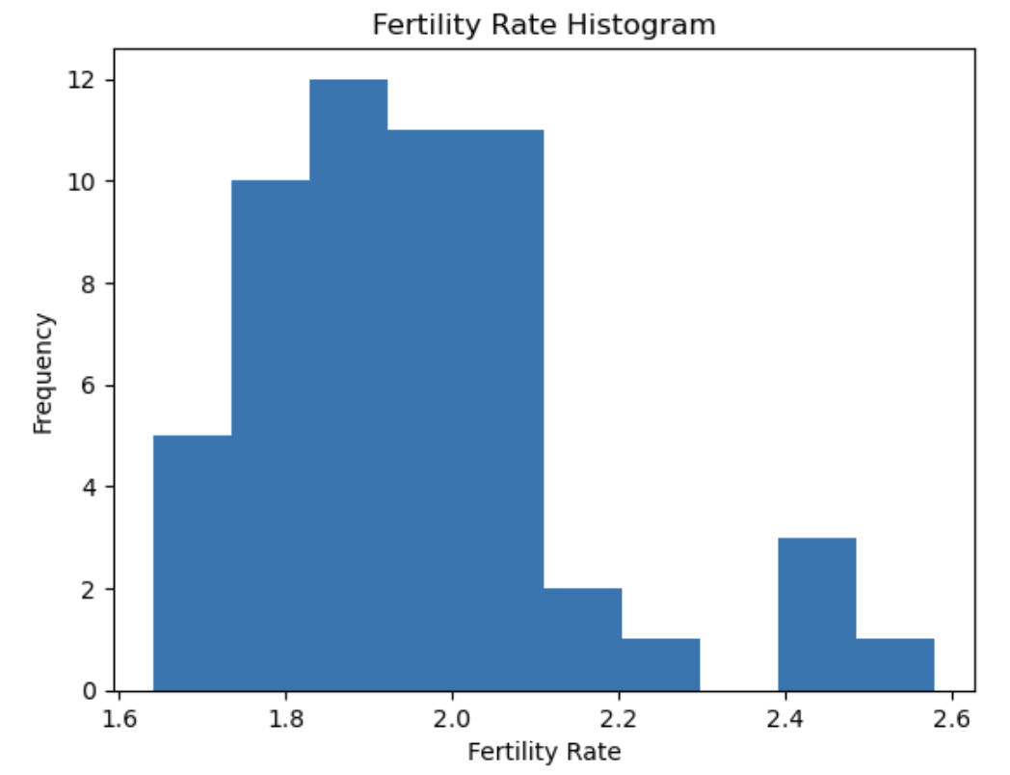
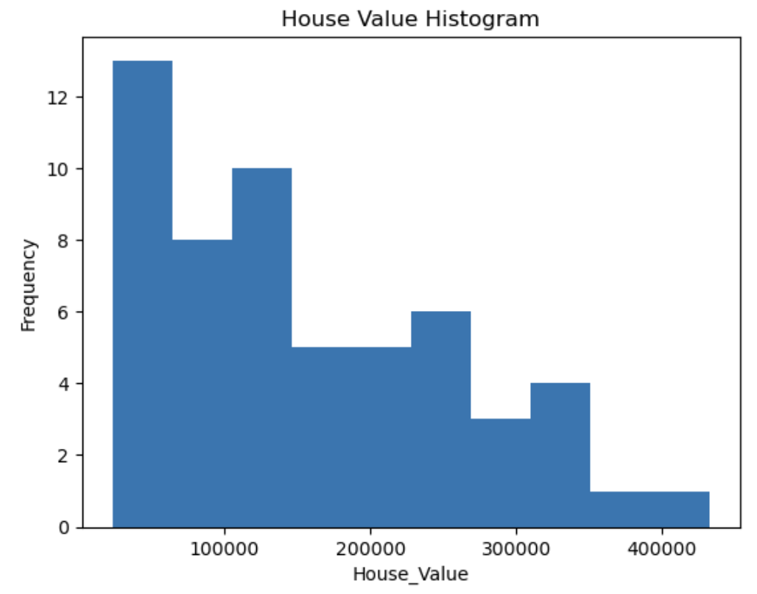
Histograms Cont’d
Fertility Rate & House Value
In Fertility Rate, there are outliers around the 2.4-2.6 range, this is mainly due to our data being used towards the tail end of the baby boomer generation where there was a higher fertility rate. In House Value, there are outliers around the 350000-400000 range, this is due to the increase in housing prices over the last few years. These outliers are to be kept as removing them would get rid of important data for that year.

Slide 6
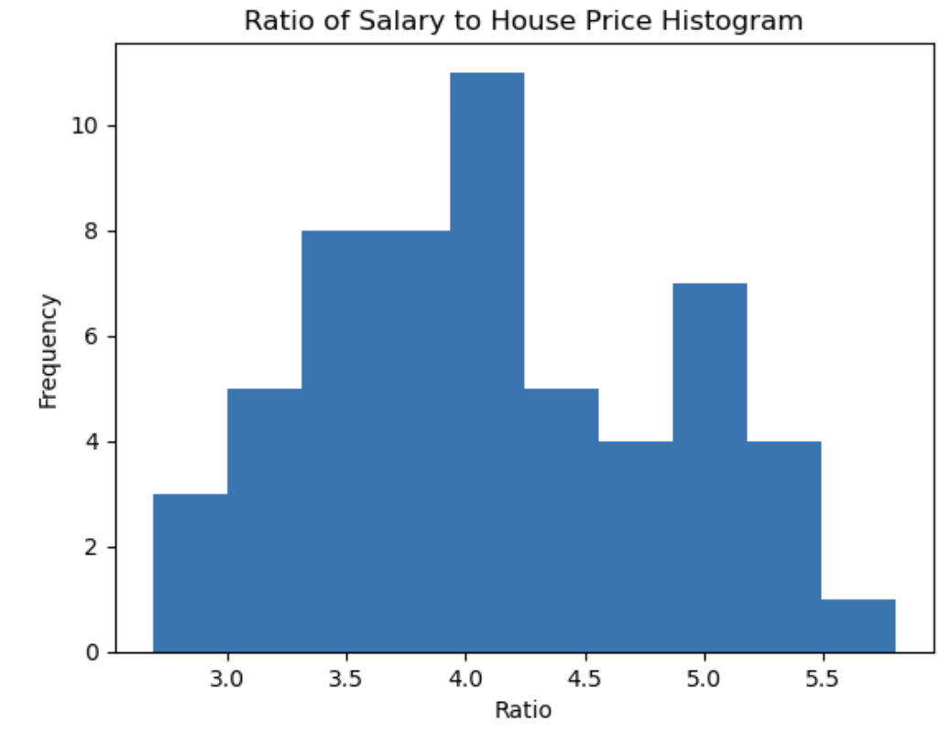
Histograms Cont’d
Ratio of Salary to House Price
In Ratio of Salary to House Price, we see an outlier around the 5.5 range. This means that for those frequency years, the average house price was 5.5x more than the average salary. While it is not an extreme outlier, it is important to keep as it provides important economic information in regards to house prices and salary affordability.

Slide 7
Descriptive Statistics
Annual_Salary
Total_Fertility_Rate
count 56.000000
mean 34858.107143
std 18870.788338
min 7143.000000
25% 18730.000000
50% 33170.000000
75% 49847.500000
max 74580.000000
var 356106652.4974027
count 56.000000
mean 1.953750
std 0.202875
min 1.640000
25% 1.817500
50% 1.930000
75% 2.050000
max 2.580000
var 0.0411584090909091
Avg_Population
count 5.600000e+01
mean 2.659165e+08
std 4.278909e+07
min 1.974570e+08
25% 2.289058e+08
50% 2.647020e+08
75% 3.047634e+08
max 3.332876e+08
var 1830906289077308.8

Slide 8
Descriptive Statistics Cont’d
CPI
House_Ratio
count 56.000000
mean 152.411964
std 76.103888
min 34.710000
25% 87.125000
50% 158.860000
75% 216.487500
max 294.310000
var 5791.80177607143
count 56.000000
mean 4.117358
std 0.742807
min 2.687772
25% 3.607024
50% 4.003944
75% 4.693749
max 5.805176
var 0.5517621561659878
House_Value
count 56.000000
mean 156339.285714
std 105484.774091
min 22750.000000
25% 67900.000000
50% 131950.000000
75% 231300.000000
max 432950.000000
var 11127037564.935062

Slide 9
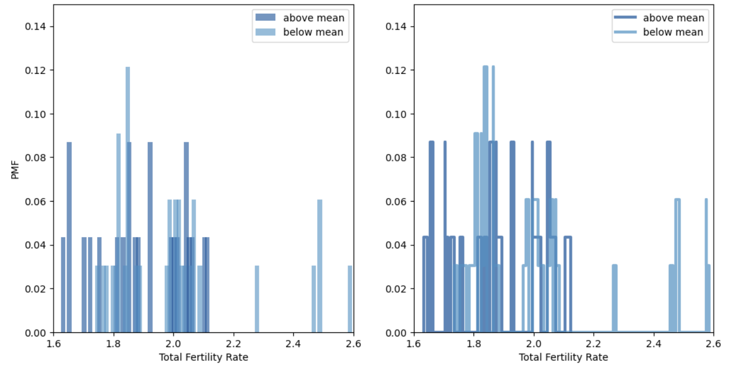
PMF
Total Fertility Rate
The PMF charts show that the distribution of Fertility Rates for both above and below mean House_Ratio prices are similar with peaks around 1.8-2.0 Total Fertility Rates. Below means ( houses that were less than 4.11x the salary) appear to be more dispersed which indicates a wider range of Fertility Rates with lower probabilities. The above means (houses that were more than 4.11x the salary) have more concentrated PMFs that indicate that higher Fertility Rates are less frequent but more consistent.

Slide 10
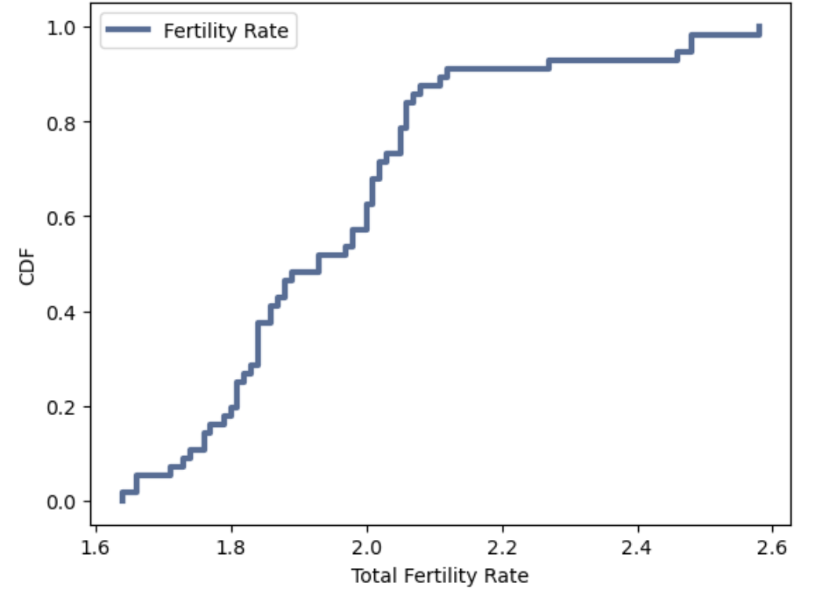
CDF
Total Fertility Rate
The CDF indicates that most Fertility Rates are clustered between 1.7 and 2.0. It also shows that extreme values are less common indicated by the shallow slopes on the far left and right end-points. A stable Fertility Rate is 2.0, which the clustered points around 1.7-2.0 indicate a slightly less stable growing population.

Slide 11
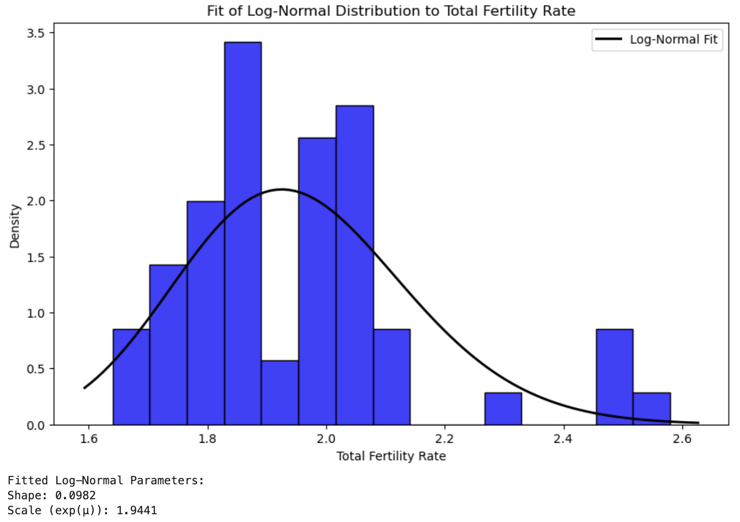
Analytical Distribution
Log-Normal Distr. to Total Fertility Rate
The shape parameter (0.0982) is small and indicates that the spread of the data after taking the logarithm is not very large and Fertility Rates are somewhat tightly clustered around the central values. The scale parameter (1.9441) represents the median data and suggests that central tendency is somewhat aligned with the central peaks.

Slide 12
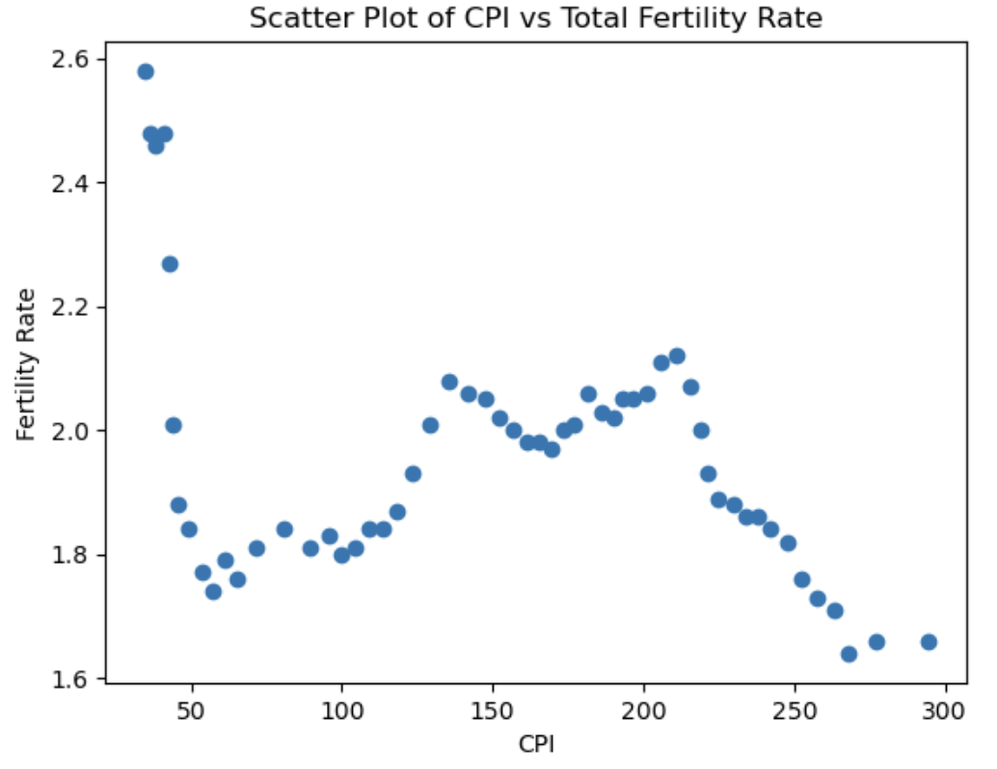
Scatter Plot
CPI & Total Fertility Rate
There is a non-linear relationship between the two variables and that it may vary depending on the range of CPI values. There is a negative correlation between the two as we get to above 100 CPI. As CPI increases, and after 200 CPI, as it continues to increase, Fertility Rates tend to decrease. Causation cannot be directly inferred and may point to other underlying influences.

Slide 13
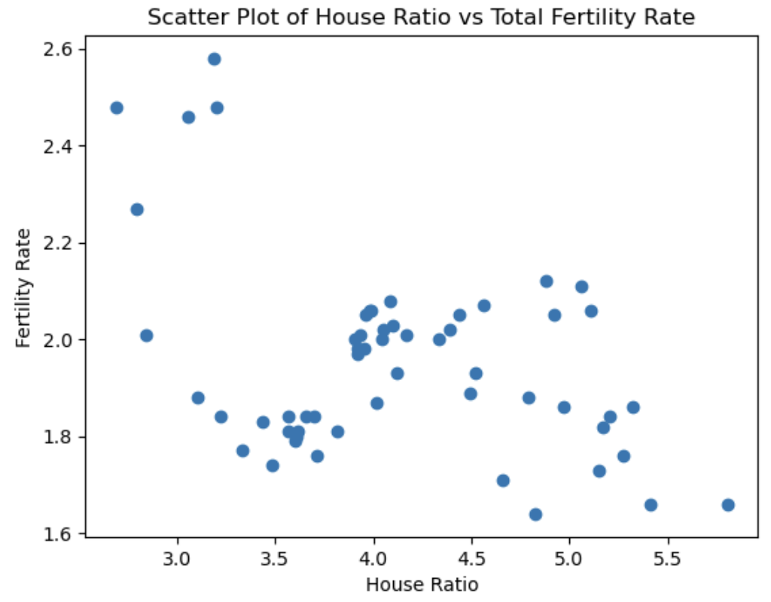
Scatter Plot Cont’d
House Ratio & Total Fertility Rate
There is a non-linear relationship between the two variables. There appears to be a weak negative correlation between House Ratio and Fertility Rate, suggesting that as the amount of houses go up in relation to salary, fertility rates may decline. Causation cannot be directly inferred and there may be other underlying influences that affect fertility rates.

Slide 14
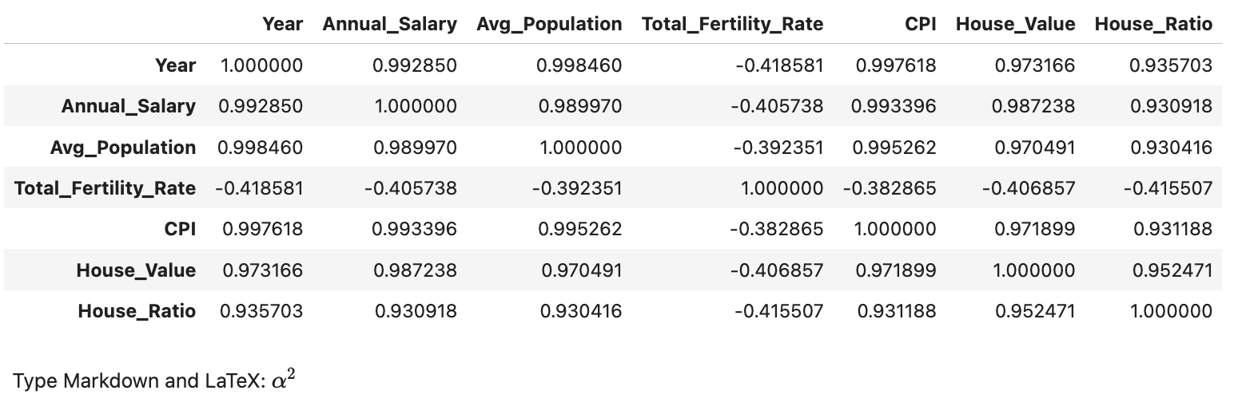
Correlation Test (Hypothesis Test)
When comparing Fertility Rate amongst all variables, there seems to be a weak to moderate negative correlation between them. This suggests that as the other variables (Salary, Population, CPI, House Value, and House to Salary Ratio) increase, Fertility Rate may decrease.

Slide 15
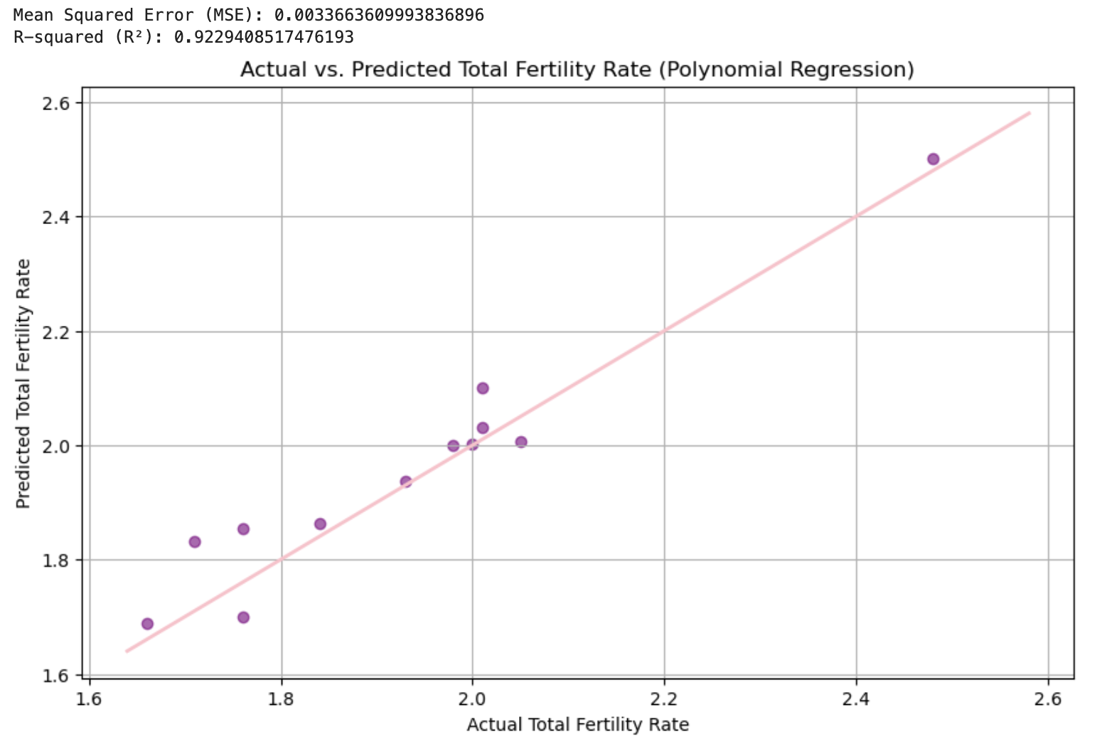
Regression Analysis
Polynomial Regression
A polynomial regression was done on Total Fertility Rate as the dependent variable, and the rest (Salary, Population, CPI, House Value, and House Ratio) as explanatory variables. Plotted is the actual Total Fertility Rate vs the Predicted Total Fertility Rate. The pink line represents a perfect prediction and the purple dots represent the actual predictions from the model. Overall, the polynomial regression model seems to be a good fit in predicting Total Fertility Rate against the other variables.

